Slide 1



I-Track
Because we track it
for You
Team :
Salaheddine EL BAIDOURY
Abdelhadi ESSABRI
Mohamed SAIDI
Abdelali JADELMOULA
Chaimaa EL KABBACH
Ikram BEL ARMIA

Slide 2








OVERVIEW ABOUT I-TRACK
I-Track is a part of the IT/ Technology Services, was established in 2021.
One such path breaking technology is tracking based on GPS.
We at, ITrack, have used this technology for providing innovative services.
WHO ARE
WE :
We, at I-Track, are fully dedicated to ensure the best tracking services for all our clients. We provide services related to tracking available in four domains :
WHAT WE
DO :
Personal Tracking
Vehicle Tracking
Pets Tracking
Mobile Tracking

Slide 3




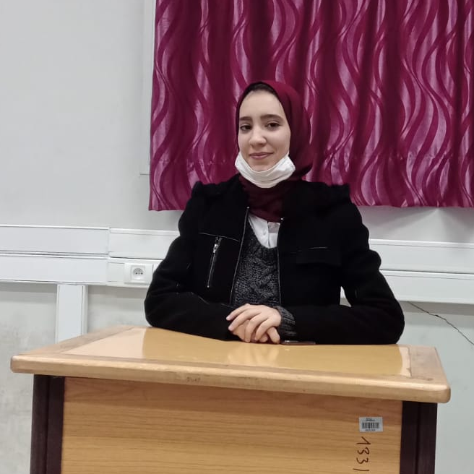
OUR MEMBERS :
THE EXECUTIVE TEAM MEMBERS
Salaheddine EL BAIDOURY
Abdelhadi ESSABRI
Abdelali JADELMOULA
Project Manager
IT Architect
Data Scientist
Cloud Engineer
DevOps Developer
Mohamed SAIDI
Chaimaa EL KABBACH
Ikram BEL ARMIA
Software Developer
Designer
Data Analyst
Data Engineer

Slide 4

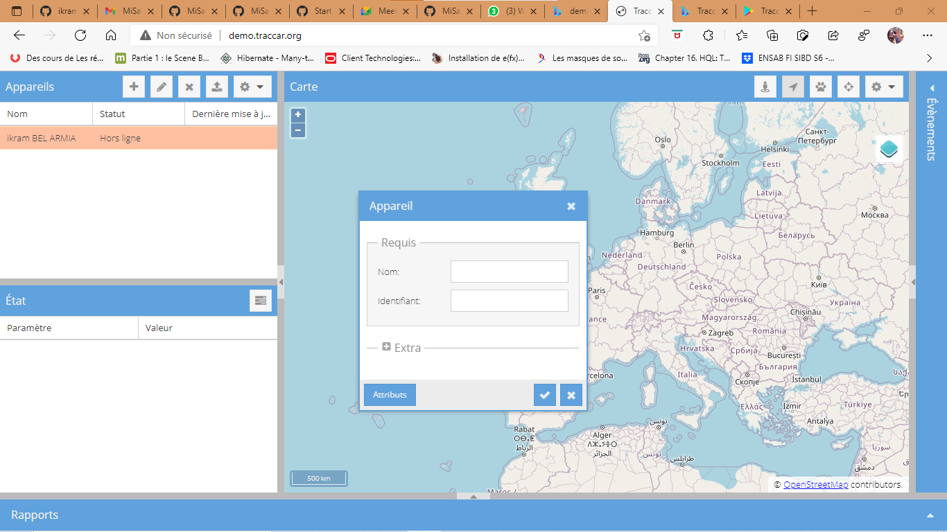



OUR FIRST PROJECT :
A group of people
Store the data generated by the group in the traccar sever
Determine the places visited by each person
Analyze the collected data
The Tracking can be done using traccar client application
Reporting

Slide 5
OUR FIRST PROJECT :

Slide 6
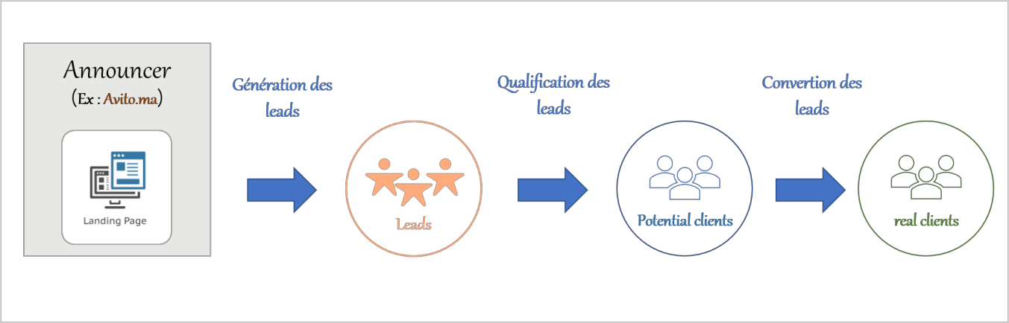
OUR FIRST PROJECT :

Slide 7
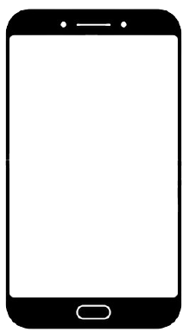
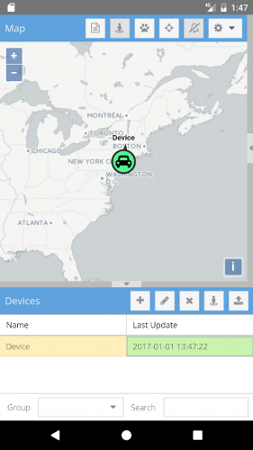
OUR FIRST PROJECT :

Slide 8
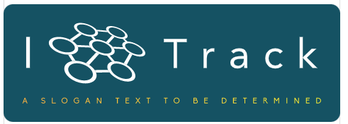


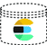


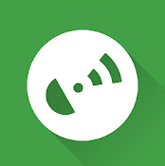
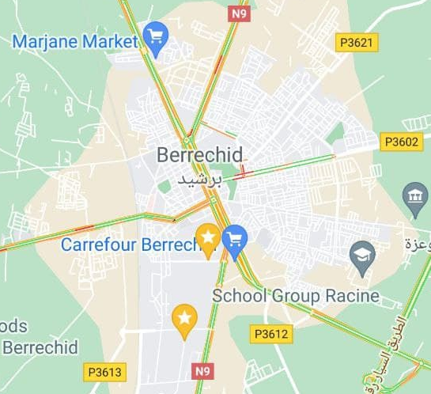



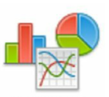

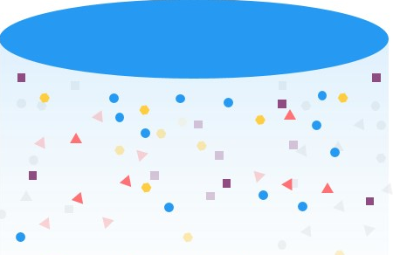
The main functional architecture of the project :
Data Source
Streams Processing
Data Reporting
Handle generated data in real time
Data Ingestion (Broker)
Serving Data
Data Processed
Data Server recipient
ETL Process
Heatmap
Advanced Computing
GPX Data Format
Advanced Analytics Algorithm
Data Lake – Long Term data Storage
Traccar application’s users
Persist Raw Data
ML Algorithm calculation
Dashboard, Reports

Slide 9
Progress Level
Traccar Client (Application)
Traccar Client is an application that allows you to use your mobile device as a GPS tracker. It reports location to your own or hosted server with selected time intervals.

Slide 10
To start using Traccar on your own system follow the steps below:
Download and install Traccar
Start Traccar service
Open web interface (http://localhost:8082, if connecting locally)
Log in as an administrator (default user - admin, password - admin) or register a new user
Add a new device with unique identifier
Configure your device to use appropriate address and port

Slide 11
To see your device on map you can register on
http://demo.traccar.org/
and add your device with identifier.

Slide 12

Current Step
Bind the application to the server
Traccar Client (Application)
Traccar Client (Server)

